Slide 1
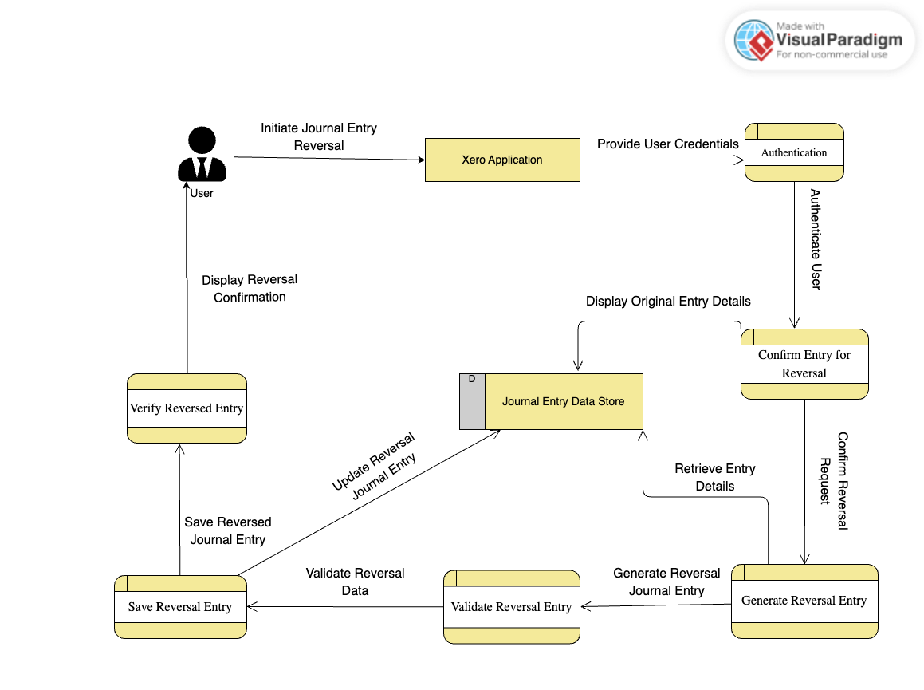
4.15 Reversal of Journal Entry

